Slide 1
Breaking the mass-inclination degeneracy of radial velocity measurements via monitoring von Zeipel-Lidov-Kozai cycles: implications in the HD 41004 system
Reporter: Zhizhen Qin (MSc, SYSU-> PhD, HKU)
Supervisor: Shang-Fei Liu (SYSU)
Tsinghua University, Department of Astronomy, 2025.7.7
Notes:
Good afternoon, everyone. Thank you to the faculty and to my college classmate, Zhecheng Hu, for hosting this talk. This is my first informal talk and also my first presentation at Tsinghua, so I really appreciate this opportunity.
First, I’d like to briefly introduce myself. My name is Zhizhen Qin. I recently completed my Master’s degree at Sun Yat-sen University under the supervision of Prof. Shang-Fei Liu. This autumn, I will be starting my PhD studies at the University of Hong Kong under the supervision of Prof. Man Hoi Lee.
The topic of today’s presentation is XXXXXXXXXX. This work was accepted by ApJ Letters last week. If you have any questions, please feel free to interrupt me at any time.

Slide 2
Contents
Background
The planets in the binary systems
Von Zeipel-Lidov-Kozai Mechanism
Implications in the HD 41004 system
Simulations
Results
Conclusions
Notes:
In this talk, I will present simulations of the potential vZLK signatures and discuss how these features may help break the mass–inclination degeneracy in radial velocity measurements, offering new insights into how dynamical evolution influences observables across different timescales. I would introduce the background of planets in the binary system as well as the vZLK mechanism.
Then I would discuss the implications in a certain system, HD 41004, to show how the vZLK mechanism would influence the planetary RV signals. Finally, I would show our results and conclusions.

Slide 3
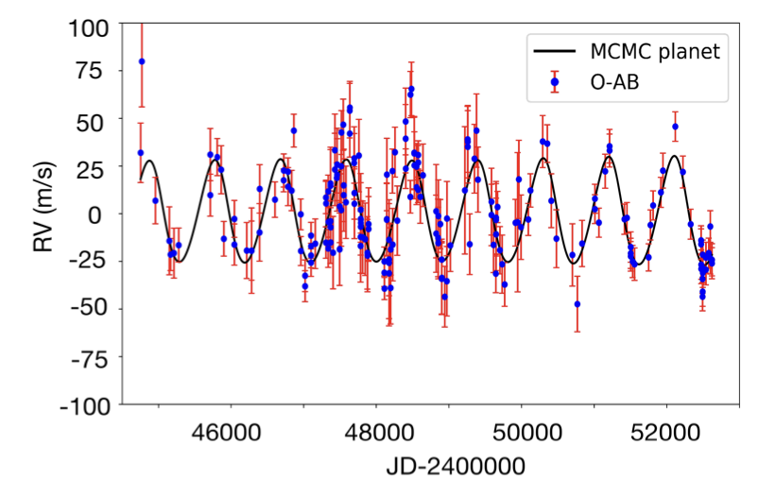
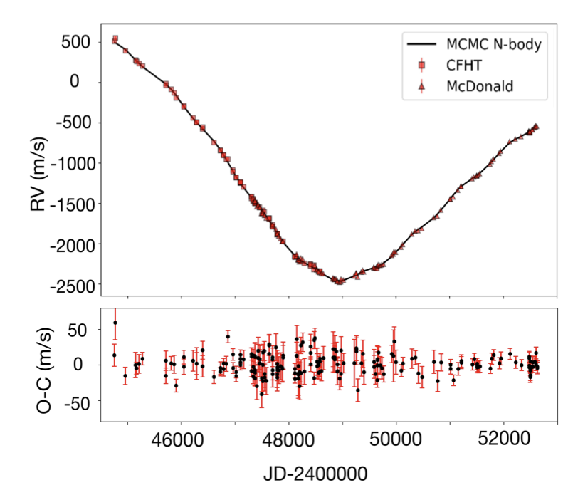
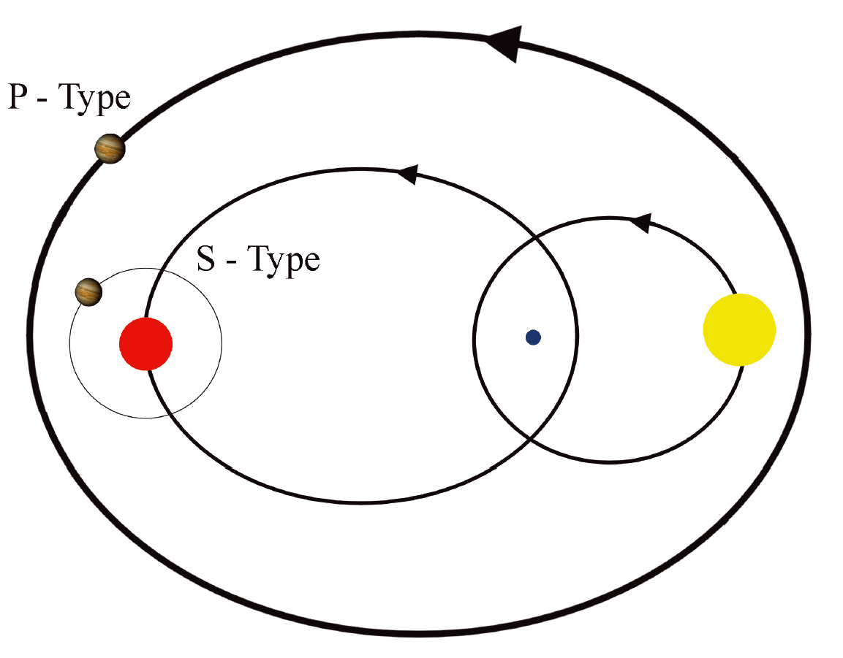
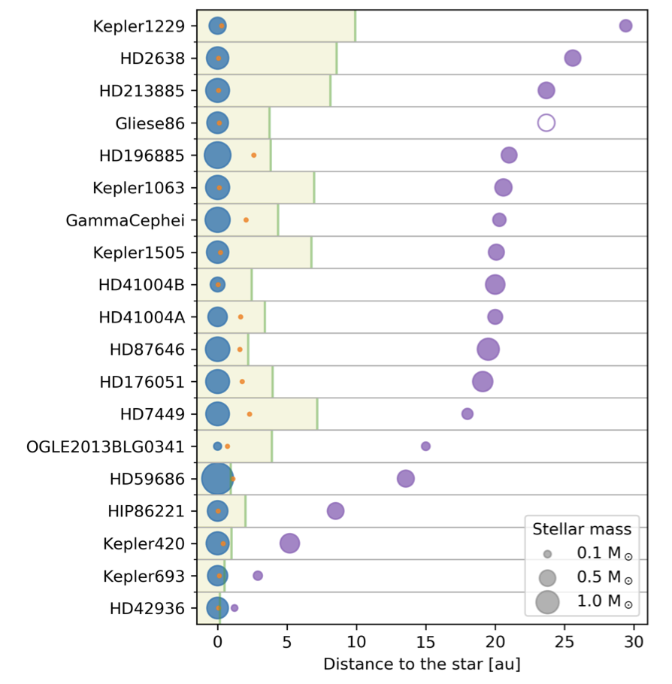
The planets in the binary systems
Binary or multiple star systems are common in universe – a small number of planets in such systems are discovered.
The complex dynamical environment motivate astronomers to discuss the stability and evolution in such systems .
Most planets are S-type, and discovered by radial velocity measurements.
Schwarz et al. 2011
Chauvin et al. 2023
Huang et al. 2022
Notes:
Although a significant fraction of stars are expected to reside in binary systems, according to the famous work done by Duquennoy and Mayor in 1991, only a small number of planets in such systems have been discovered so far. This disparity reflects both the observational limits and the dynamical instability in binary environments.
Usually, the planets in binary systems are divided into two types, as shown on the left figure: S-type ( the planets orbit one star in a binary system) or P-type (the planets orbit both of the stars). Many works have been done to investigate the stability, habitability ( the first planet discovered is in a binary system), and evolution of such systems. The middle figure shows some of the compact binary systems with S-type planets. The formation mechanism of those planets remains an open question. Like the planet in the famous binary-planet system, gamma Cephei (仙王座 gamma), most S-type planets are discovered by radial velocity measurements, as shown in the right figure. The red dwarf companion causes the RV of star A in kilometers. But you can see in the O-C figure, there is a small amplitude oscillation, and recognized as a planetary signal in later confirmation. With longer observational baselines, more and more similar planets are discovered.

Slide 4
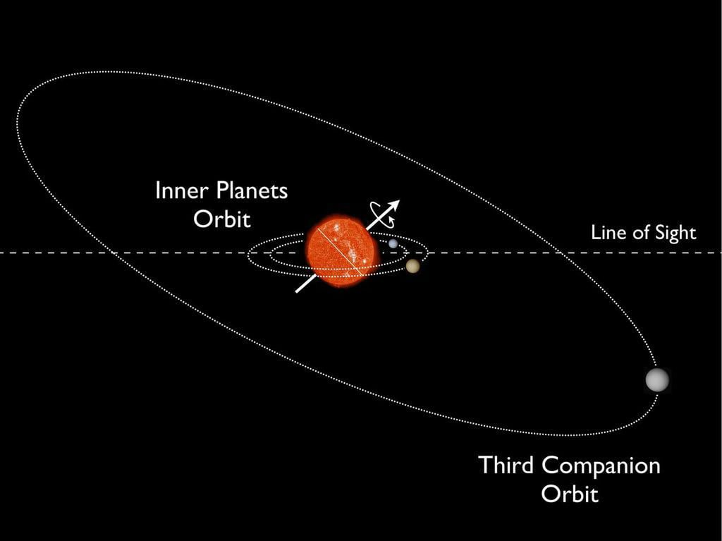
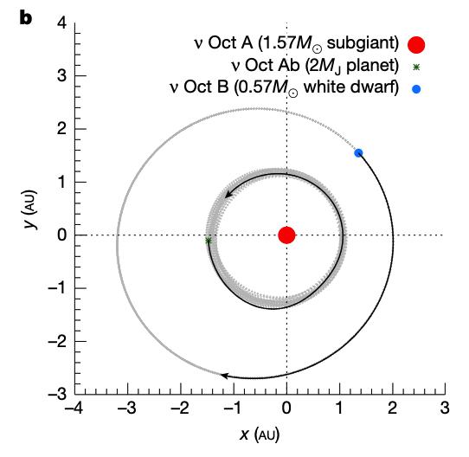
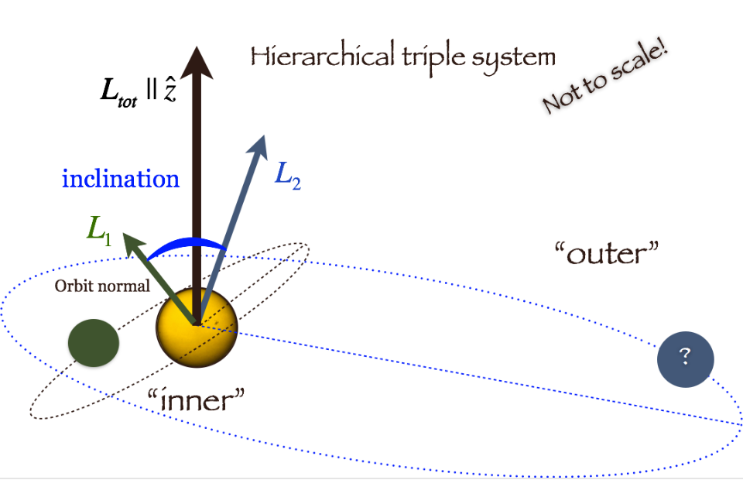

The planets in the binary systems
Some planets might be misaligned or retrograde with eccentricity – $γ$ Cephei, $ν$ Oct, HD 80606b…
The evolution of misaligned or retrograde hierarchical three-body systems – von Zeipel-Lidov-Kozai mechanism
Huber et al. 2013
Cheng&Lee et al. 2025
Naoz et al. (2011a,2013)
Notes:
Also, some planets in the hierarchical systems show misalignment, in inclined or retrograde orbits with eccentricities. For example, Kepler-56 has been discussed as an inclined system, and recently Professor Lee found a system with a retrograde planet in close eccentric binaries, as I show in the middle figure. Also, a famous system, HD 80606, has been proposed as misaligned in its evolution.
When it comes to inclined hierarchical systems, usually the von Zeipel-Lidov-Kozai mechanism governs their evolution. In the right figure, when there is a central star and an outer companion body, if the inner body around the central star is inclined with the outer body (for example, the blue vector is not towards the green vector), these systems would experience oscillations in eccentricity and inclination.

Slide 5
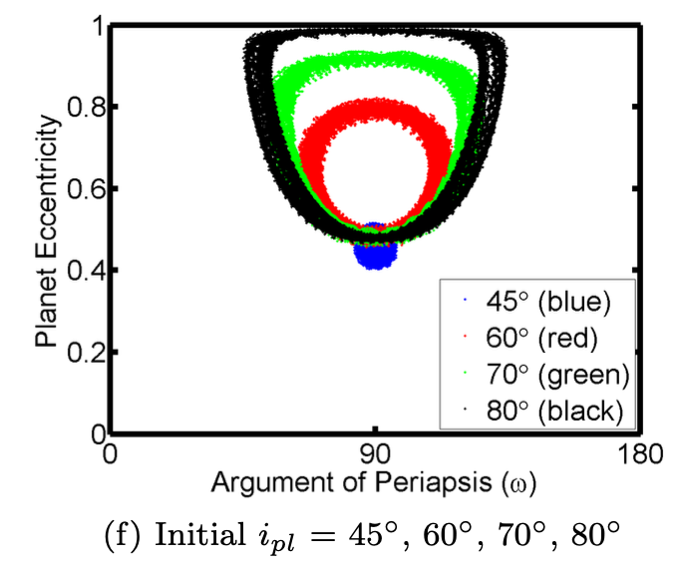
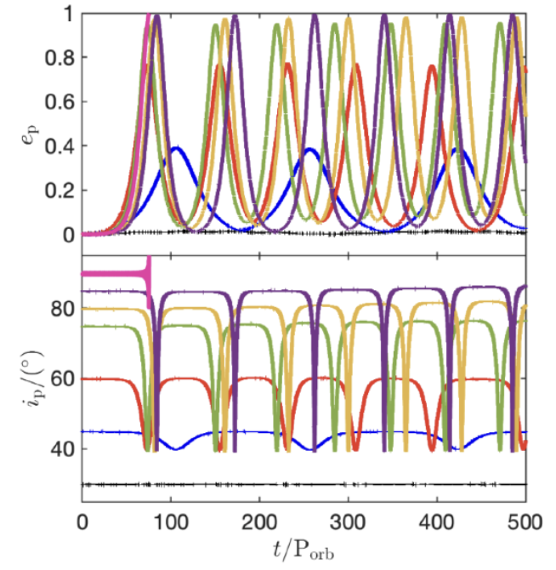
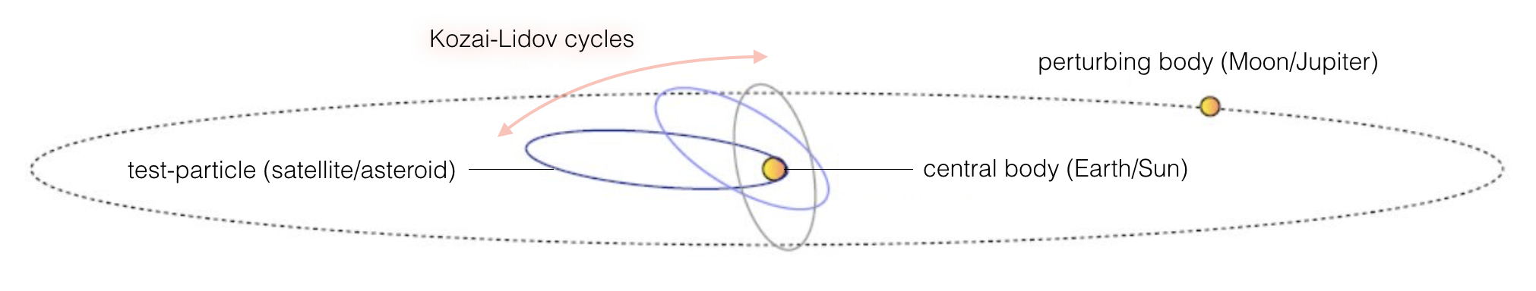

Von Zeipel-Kozai-Lidov (vZLK) mechanism
vZLK mechanism - oscillation in eccentricity and inclination.
vZLK timescale - $t_{vZLK}∼\frac{16}{15}{\left(\frac{a_{2}}{\sqrt{a_{1}}}\right)}^{3}\sqrt{\frac{m_{0}}{Gm_{2}^{2}}}\sqrt{{\left(1−e_{2}\right)}^{3}}$ - governed by the binary’s eccentricity and period.
Onset of oscillation: ${39.2}^{o}$ - ${140.8}^{o}$, locked in libration (like MMR).
Satyal et al. 2014
Smallwood et al. 2022
Notes:
As the figure shows, the vZLK mechanism was established to explain the asteroid's secular evolution under the perturbation of Jupiter as well as the satellite's orbit variation under the influence of the Moon.
When the inclination between the inner body and the outer body is beyond approximately 40 degrees, the inner orbit would oscillate in eccentricity and inclination due to the angular momentum exchange.
As I show in the left figure, this oscillation timescale and also the oscillation range could be derived from simulations. The video shows the changes in eccentricity and inclination, as well as changes in the angular momentum vector's direction.
Then this figure on the left shows that when the planet is in vZLK oscillation, the argument of periastron would be locked in libration with precession (around 90 or 270 degrees), the same as MMR.
When it comes to the timescale of the vZLK mechanism, it depends strongly on the outer body‘s period and eccentricity, as the inner body is usually recognized as a test particle. This secular timescale is usually much longer than the inner body’s period, from thousands to millions of years in different system configurations.

Slide 6
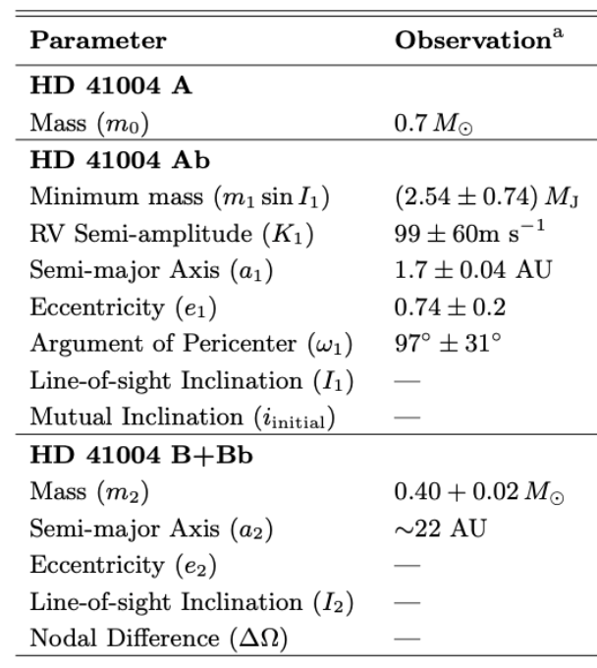
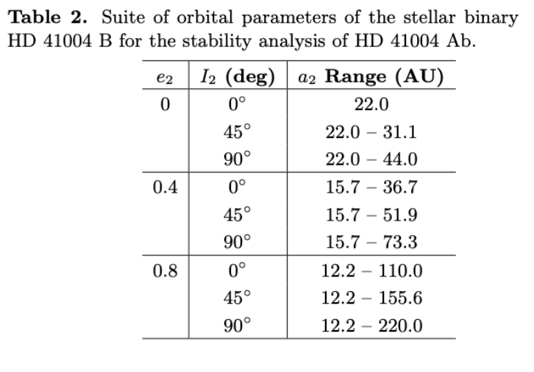
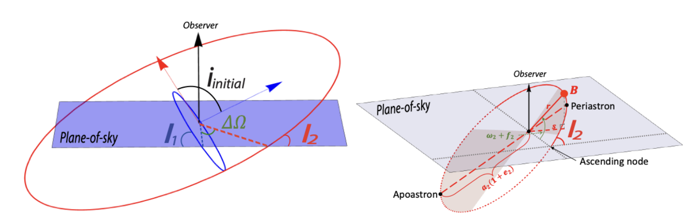

Implications in the HD 41004 system
HD 41004: a hierarchical four-body system – both star hosts a planet
Approximation: unrestricted three-body simulation
Notes:
After introducing the background, I would show some implications in the system HD 41004.
The HD 41004 system is a hierarchical four-body system with both planets orbiting both stars.
In the left figure, I show the orbital architecture of this system, as the red orbit denotes the companion‘s orbit. The blue orbit denotes the planetary orbit. The angle between the orbital momentum vector is the system’s mutual inclination, i_initial, is an intrinsic configuration. For radial velocity measurements, the observational inclinations are I_1 and I_2, and their relation is in the bottom line.
In the left figure, I show the system parameters from previous RV observations. The star is about 0.7 solar mass, with a planet in 2.6M_J's minimum mass. The planet orbits Star A in 1.7 AU with 0.74 eccentricity, and the binary companion, 0.4 solar mass, is at approximately 22 AU's projected separation. In our simulations, we simplify the B and Bb into one body and use unrestricted three-body simulations with the mass-inclination degeneracy inherent RV measurements to assess the orbital stability of different system configurations.
Because of the short observational baseline, the orbit of star B is poorly constrained. To better characterize this system, we vary the observational inclination I_2 to three representative values, 0, 45, and 90 degrees, from edge-on to face-on, and also vary the eccentricity of B (e_2) to run stability tests. Because the planet must be in stable orbits even for inclined configurations at first. As I show in the right figure, we consider a varied range of possible orbits of B, and the full set in stability simulations is in the right table.

Slide 7
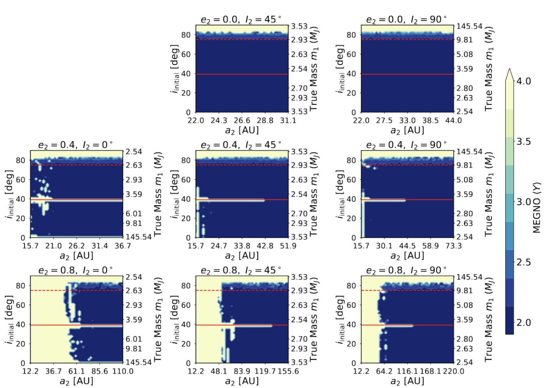
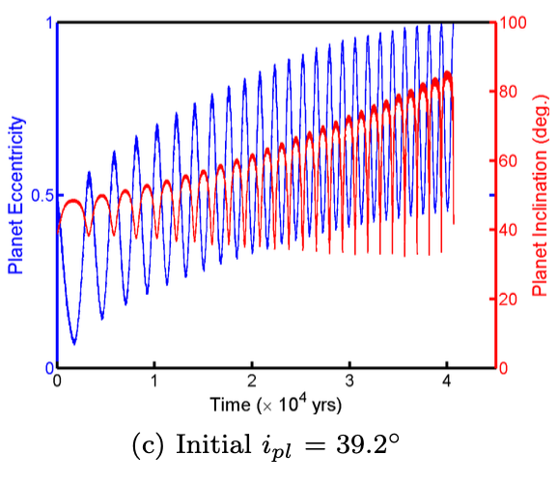
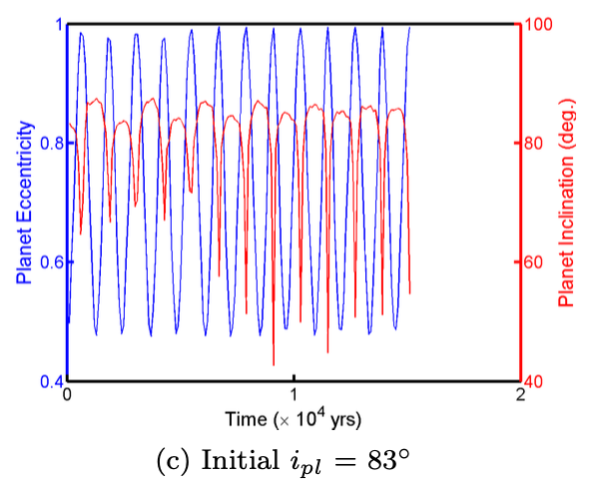

Stability - Can the system be misaligned and stable?
Using the MEGNO chaos indicator – quick to identify unstable orbits.
Unstable regions:
1. Mutual inclination up to 75 deg
2. Mutual inclination around 40deg
3. Eccentric close orbits of B ($a_{2}$)
Satyal et al. 2014
Notes:
So our primary question is whether the vZLK mechanism could be in real planetary systems, and how it would affect the radial velocity of the planet. Then the following question is , can the system be misaligned and stable?
Following the parameters we derived, we use the MEGNO chaos indicator to identify unstable regions of different observational inclination I_2, the binary’s eccentricity e_2, varying the mutual inclination i_initial and the binary’s semi-major axis a_2. Because there is mass-inclination degeneracy in radial velocity measurements, we derive the I_1 from mutual inclination and I_2 from the previous equation I show in the last slide, accounting for mass inflation in lower observational inclination I_1. The left figure shows the results. The blue region means stable orbit, and the yellow region means unstable orbit. We run simulations for 2 Myr, sufficient for stability test.
In the top row, the binary’s orbit is circular, and for I_2=0, the orbit is excluded, because the orbit is fixed. The left y-axis is mutual inclination, and the right y-axis is the planet’s true mass due to the mass-inclination degeneracy. The x-axis is the binary’s semi-major axis a_2. Across different configurations, the stability maps suggest a stable region with mutual inclination up to 75 degrees. In an eccentric binary orbit, there is an unstable region near 40 degrees, the onset of vZLK oscillation. This is because the planet starts the vZLK oscillation but is not locked into libration, disrupting stability as shown in the left figure in the right corner. For highly inclined orbits ( for example, higher than 75 degrees), the maximum eccentricity of the planet is so big that it experiences a close encounter with star A, leading to instability, as shown in the right figure in the right corner.
For eccentric binaries, a small a_2 also causes instability, as the reduced periastron could make the planet suffer a stronger gravitational perturbation. Also, for I_2 = 0, face-on orbit, if the mutual inclination is zero, the true mass of the planet would be very large, which also causes instability.
In general, numerical simulations reveal a persistent stability limit of i_initial ~ 75 degrees, which remains robust across variations in planet Ab’s true mass and observational inclination.

Slide 8
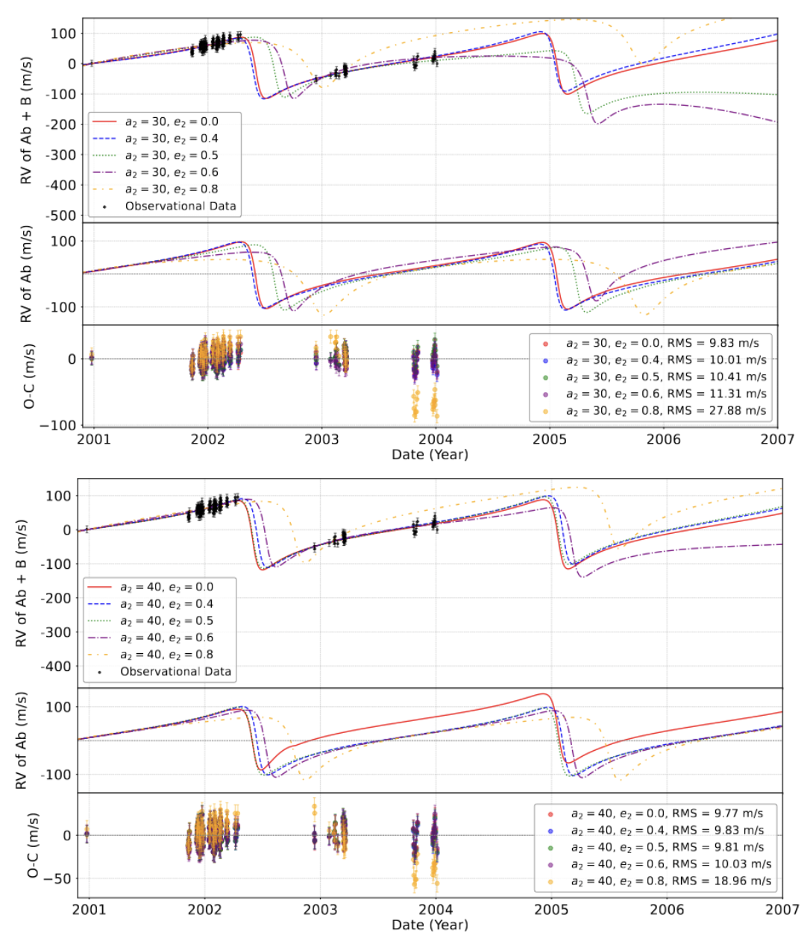
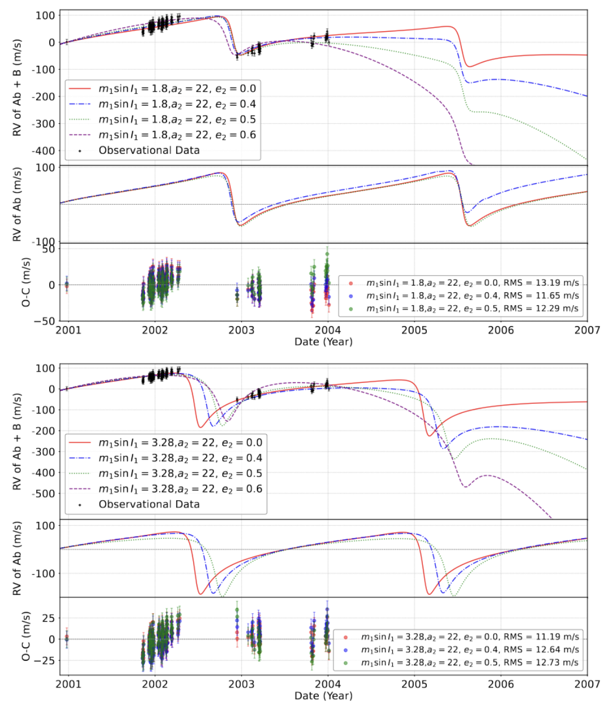
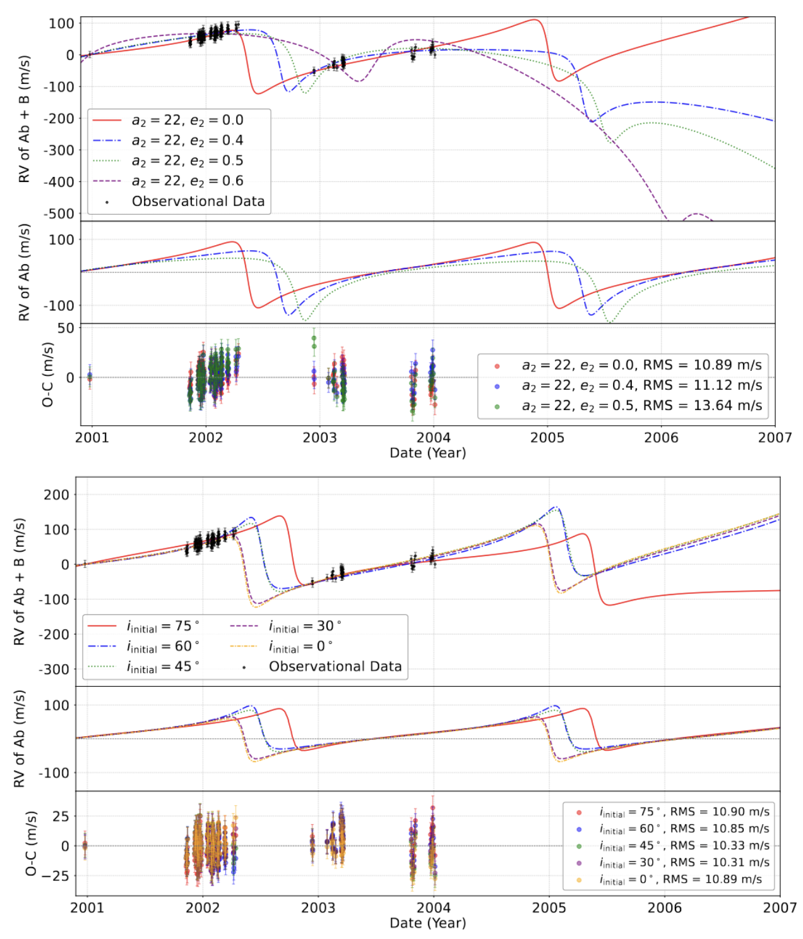


Observation - Can the misaligned configuration fit the radial velocity data?
Existing RV data: planetary signals primary, weak constraints on the HD 41004 B.
$a_{2}=22AU$, different $i_{initial}$
$a_{2}=22AU$, different $e_{2}$
Notes:
After checking the stability across different configurations, the second question is "can the misaligned configuration fit the existing radial velocity data?"
The RV of this system is from a previous observation from 2001 to 2002. Due to the short time baseline, the RV signal is recognized as primarily a planetary signal, having weak constraints on the binary companion.
So we run a dynamical modeling using the rebound, simulating the velocity of star A, and fit it with the data. We run different tests over different parameters, for example, different mutual inclinations and different binary eccentricities.
The results show that the binary may be low to moderate eccentric, in all inclinations from 0 to 75 degrees. We also search for wider binary orbits and different minimum planet masses. The results remain the same. Current observation can only tell that the binary is probably in low to moderate eccentricity, and does not reject the assumption that this system is a compact binary.

Slide 9
From simulations, we know:
The system can be stable in a compact eccentric configuration with planets misaligned.
The RV of HD 41004 A can fit different system configurations.
In misaligned systems, the vZLK governs the evolution pathway.
Can vZLK exist in this system? – Simulations do not reject this assumption.
What are the observational signatures of vZLK planets?
Could the signatures be observed by current or future instruments?
Notes:
To sum up, from simulations, we know that: from stability maps and dynamical modeling, the simulations show that the binary could be in a close and moderate eccentric configuration, with the planet in mutual inclination up to 75 degrees. So the results do not reject the assumption that this planet is in vZLK oscillation.
So the next question is, what are the observational signatures of vZLK planets? Could the signatures be captured by current or future instruments?

Slide 10
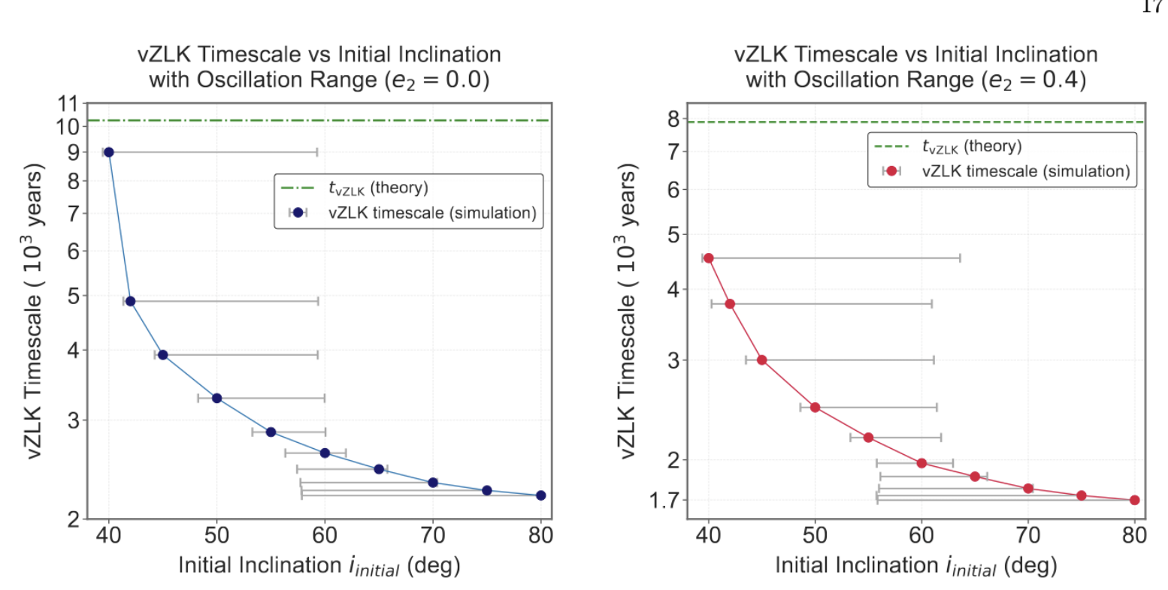
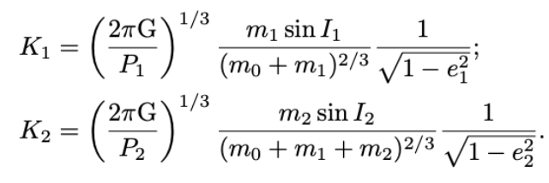
Radial Velocity Measurements
In unrestrecited three-body simulations, the vZLK timescale decreases with inclination, with larger inclination oscillation range.
The planets in compact and eccentric binaries are more sensitive to the RV measurements: larger oscillation range, smaller vZLK timescale.
Radial Velocity of a hierarchical three-body system:
vZLK oscillation modulates the eccentricity and inclination in thousands of years.
The eccentricity shapes the RV curve.
Mass and inclination are degenerate.
Lee&Peale 2003
Notes:
The planet in HD 41004 was discovered by radial velocity measurements. When it comes to RV detection, the semi-amplitude of RV and the shape of the RV curve are influenced by its eccentricity and observational inclination. If the mutual inclination and the eccentricity vary during vZLK cycles, the RV of the planet changes together. Also, for the mass and inclination degeneracy, the changes in inclination would cause changes in the amplitude, as the projected mass to the observer changes together.
But the vZLK timescale is at least thousands of years, could it be observed in a shorter timescale? So we first run simulations about the timescale and inclination range of different mutual inclinations, finding that a higher mutual inclination shortens the vZLK timescale, also has a larger oscillation range - which means - The planets in compact and eccentric binaries are more sensitive to the RV measurements: larger oscillation range, smaller vZLK timescale.

Slide 11
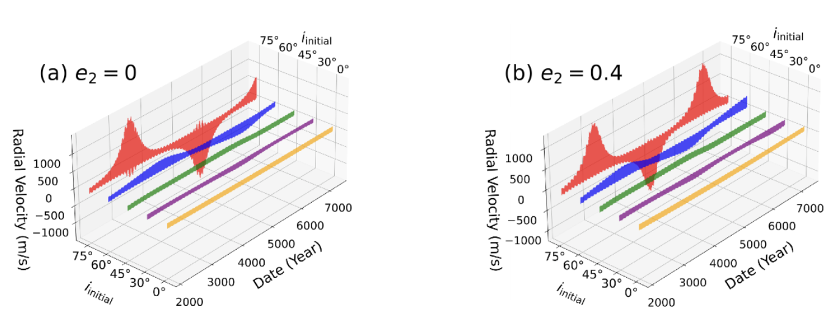
vZLK-induced planetary RV signatures
For different inclinations, the simulated RV of Ab+B fits the observation.
From the simulation, we can assess the planetary RV signals over different timescales.
Full cycle of vZLK: Changes in semi-amplitude of RV and curve shape.
Notes:
As I have shown before, we fit the observational data for various configurations in mutual inclinations. Through simulations, we can isolate the binary companion‘s signal and the planetary signal using rebound. The middle panel on the left is the planetary signal. And we can also assess the planetary RV over a full vZLK cycle, as shown on the right. You can see, because of the changes in eccentricity and inclination, that the minimum inclination with maximum eccentricity causes a peak in RV, to about 750 m/s in 75 degrees, and changes through time. For 60 degrees, this peak is lower, and for lower inclination, the RV signal is quite stationary. If there is eccentricity in the binary, the vZLK timescale would be shortened, and the changes would become more rapid. The RV also changes from positive to negative. This is because the precession of the argument of the periastron in the vZLK cycles changes the orientation of the planetary orbit.

Slide 12
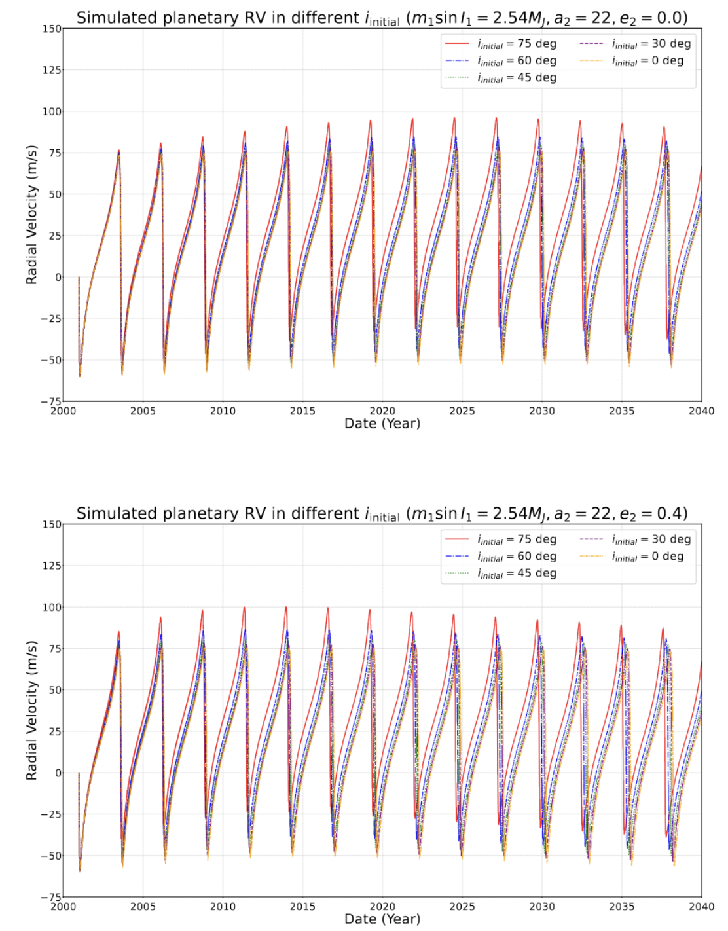
vZLK-induced planetary RV signatures
Observational decades: 1.9m/s/year for 75deg in circular binary.
For larger binary separation or lower inclination, the RV drift decreases.
Notes:
The last figure I show is about a 5000-year simulation. What about observational decades? Then we isolate a forty-year signal for different binary eccentricities. On the left is a circular binary, and on the right is a 0.4 eccentric binary configuration. The planetary signal at 75 degrees (red line) inclination would experience a drift in RV for about 1.9 m/s/year, and half of that value in 60 degrees (blue line). A lower inclination would have minimal drift.
The eccentricity of the binary would shorten the vZLK timescale, making the drift more pronounced, as you can see on the right figure, red line. Also, for nearly coplanar cases, both simulations show almost stationary Keplerian orbital RV signals.

Slide 13
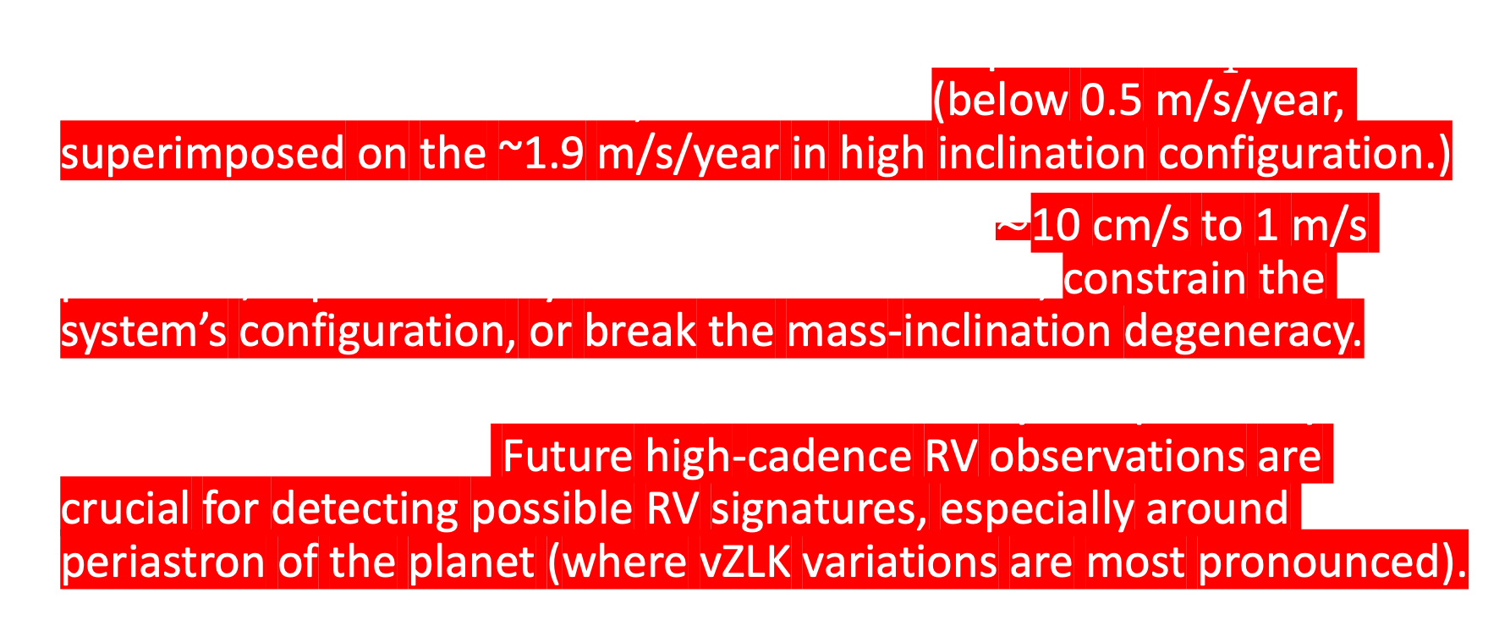
Observational Prospects for Dynamical Signatures
For a larger minimum mass, the peak semi-amplitude of $K_{1}$ increases. For a smaller minimum mass, it decreases. (below 0.5 m/s/year, superimposed on the ~1.9 m/s/year in high inclination configuration.)
Next-generation spectrographs detect RV with $∼$10 cm/s to 1 m/s precision, capture this dynamical influence on RV, constrain the system’s configuration, or break the mass-inclination degeneracy.
Combined with astronomic data, both the binary and planetary orbits could be constrained. Future high-cadence RV observations are crucial for detecting possible RV signatures, especially around periastron of the planet (where vZLK variations are most pronounced).
Notes:
We also check for different planetary minimum masses, as the uncertainty of this minimum mass is significant. But it would only produce drifts below 0.5m/s/year, superimposed on the 1.9 m/s/year in high inclination configuration.
And the next-generation spectrographs could possibly detect such dynamical signatures, constrain the system configuration, or break the mass-inclination degeneracy. For example, in future high-cadence observations, if we first constrain the binary’s orbit, and then find the planetary signal has similar drifts, then this system might be in a high inclination configuration. If there are no such signatures, this system might be in a low inclination configuration, and we need longer observational baselines or astronomical data to constrain the true orbital configuration to break the mass inclination degeneracy.
Anyway, future high-cadence RV observations are crucial for detecting possible RV signatures, especially around periastron of the planet (where vZLK variations are most pronounced).

Slide 14
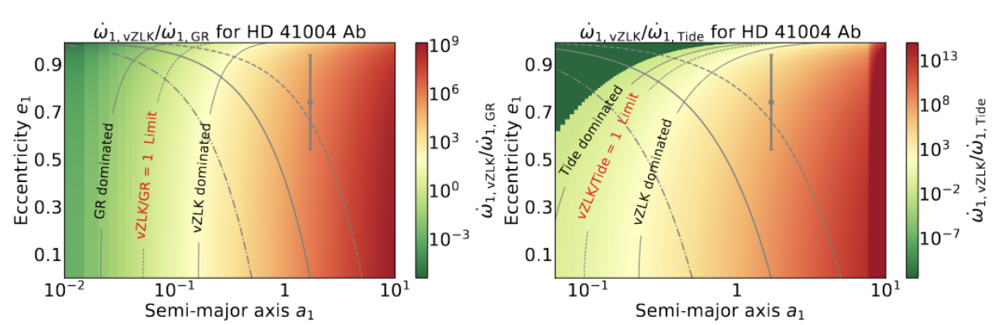
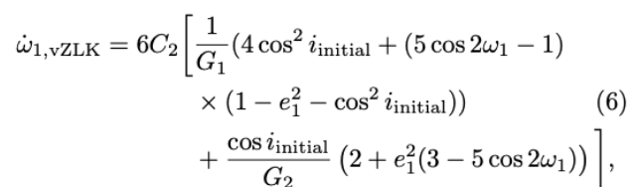
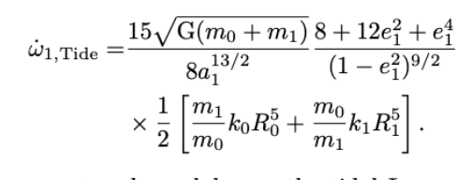
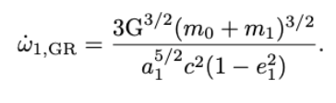

Impacts of GR and tidal effects
GR or tidal effects could suppress the vZLK oscillation (e.g., formation of hot Jupiters and shrinking the orbits of black holes).
If the precession rate of $ω_{1}$ is comparable, the vZLK would be suppressed.
In current parameters ($a_{1}=1.7AU, e_{1}=0.74)$, if the vZLK operates in this system, the vZLK oscillation would govern its evolution rather than short-range forces.
For similar systems with closer planets, the short-range forces must be considered for its dynamical evolution (e.g., GJ 86, $τ Bootis$).
Notes:
And also, other short-range forces may play a role in the evolution of this system. GR or tidal effects could suppress the vZLK oscillation, as discussed in the formation of hot Jupiters and shrinking orbits of the black holes. If the precession rate is comparable, the short-range forces would govern the evolution rather than the vZLK mechanism. So we test it in anayltical way, as shown in these equations. We find that in current configuration, if the vZLK mechanism operates in this system, the vZLK oscillation would not be suppressed in current planet parameters. But for similar systems like GJ 86, short-range forces could not be negelected due to its close configuration.

Slide 15
Take-home conclusions
The planet HD 41004 Ab can remain dynamically stable with a mutual inclination up to 75 deg. RV modeling fits the observation with compact and low to moderate binary configurations. Some S-type planets could remain stable in vZLK regions.
vZLK mechanism could produce RV signatures on the planetary signals. Our results show that the RV variation is most pronounced in a highly misaligned and eccentric compact system.
Future observations could differentiate between high and low mutual inclinations. At high inclinations (e.g., 75deg), the RV drift could reach ~ 5 m/s per planetary orbit ( ~ 1.9 m/s/year). Low inclinations exhibit minimal secular modulation, need more efforts to constrain the mass-inclination degeneracy.
Notes:
So, at last, I would summarize my talk.
The take-home conclusions are:
I think I'll stop here. If you have questions, please feel free to ask.

Slide 16
Appendix

